Slide 1
Evaluate ML Models for Wifi Locationing
by Ale f Benages.
Data analyst at IOT Analytics.

Slide 2
Pre-Processing Data
75% to fit the selected model
Training Data
Random sample of 45% of data
Multivariate Analysis
25% to test the trained model
Data
Validation Data
100% to validate the performance of the models.

Slide 3
ML Models
Models:
Logistic Regression
Random Forest Classifier
K-Neighbors Classifier
Classification:
Building-ID
Floor-ID
Metrics:
Accuracy
Confusion Matrix
Machine Learning Models
Models:
Decision Tree Regressor
K-Neighbors Regressor
Support Vector Regressor
Multi-layer Perceptron Regressor
Regression:
Latitude
Longitude
Metrics:
R squared (R^2)
Mean Absolute Error (MAE)

Slide 4
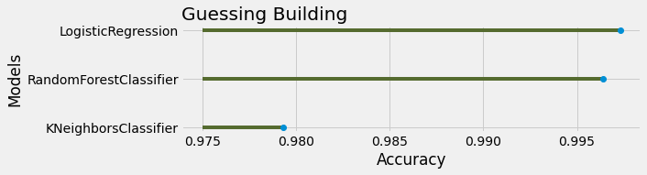
Guessing Building-ID
Building-ID it’s a categorical variable, with 3 possibilities (Building 0,1,2), and classification algorithms were fitted.
The tree selected models performed great with the unseen data from the validation dataset. KNeighborsClassifier got an accuracy of 97.93%, Random Forest Classifier: 99,64% and Logistic Regression: 99,73%.

Slide 5
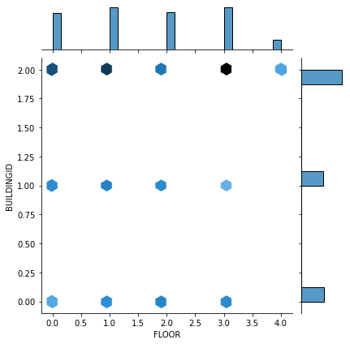
Guessing Building-ID
But perhaps accuracy isn’t the best error metric choice. Classification accuracy fails on classification problems with a skewed class distribution.
This is the graph of the data used to train the models. It shows how much data contains each combination of Building/Floor.
BuildingID = 2 is the only one with a 4th floor. So it’s logic that it contains very little data.
BuildingID = 2 contains most of the examples.
So, another metric will produce meaningful information.

Slide 6
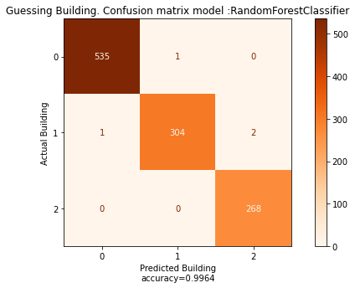
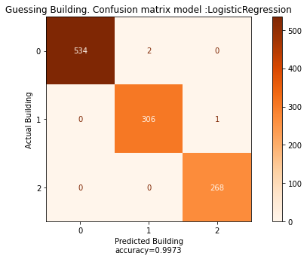
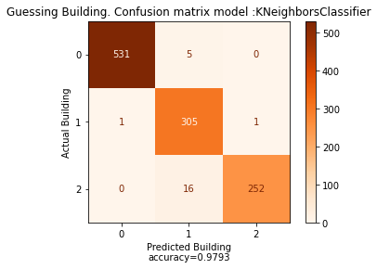
Guessing Building-ID
A better performance indicator could be a Confusion Matrix, were each row of the matrix represents the instances in an actual class while each column represents the instances in a predicted class. The diagonal contains the actual values that were correctly predicted by the algorithm, all the other values are misclassified observations.
The two first models (RF and LR) perform very well, with only 3 or 4 misclassified buildings. But again, KNeighbors is doing worse than the others.
I suggest choosing Random Forest classifier, as this model does not suffer from the overfitting (it takes the average of all the decision trees involved in the forest, cancelling the bias).

Slide 7
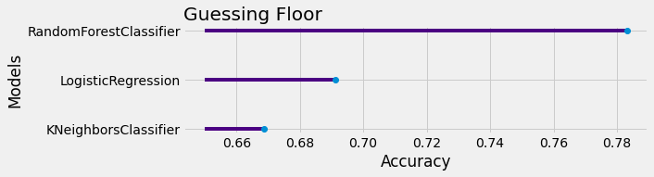
Guessing Floor-ID
The same 3 models were also trained to guess the floorID. It’s a categorical variables, and it’s a classification problem. 5 possibilities were available (Floor 0,1,2,3,4).
In this case, the accuracy was not so impressive as in the previous guessing. Again Confusion matrices will be used to get more information.

Slide 8
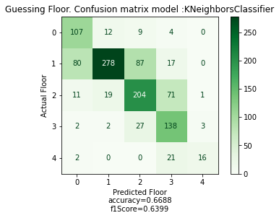
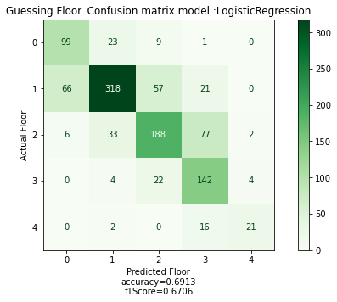
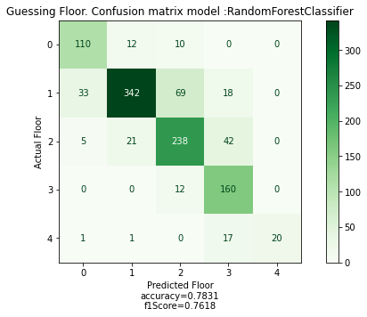
Guessing Floor-ID
A confusion matrix is a better tool to judge an algorithm, than accuracy. But with multilabel problems (as in this case where there are 5 labels), it’s not always easy to define which one is performing better by just watching the matrices. As we need to choose a model, we need one single measure to summarize model performance.
F1 score, can be interpreted as a weighted average of the precision and recall, where an F1 score reaches its best value at 1 and worst score at 0. In the multi-class and multi-label case, this is the average of the F1 score of each class.
So, again Random Forest Classifier is performing better than others. with an F1= 0.7618 (Also it’s the model with the highest accuracy).

Slide 9
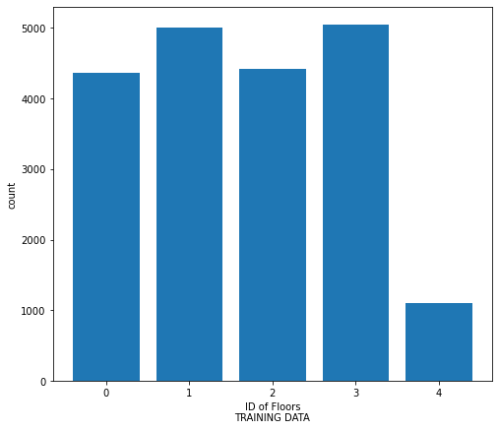
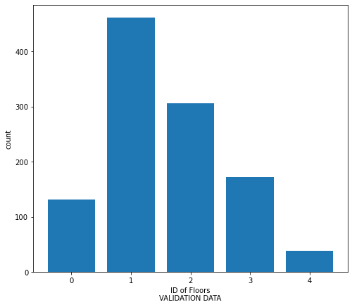
Guessing Floor-ID
I suspect that a possible cause of so many misclassified values (the ones outside the diagonal) is the great difference in the distributions of the samples between the train/test and the validation datasets.

Slide 10
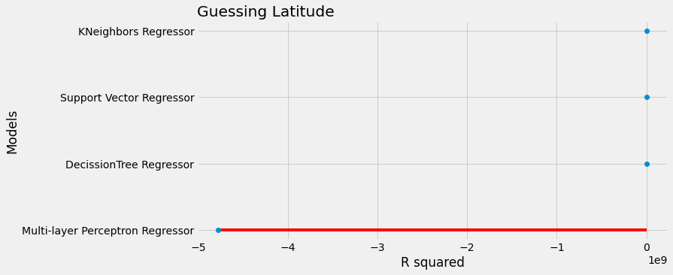
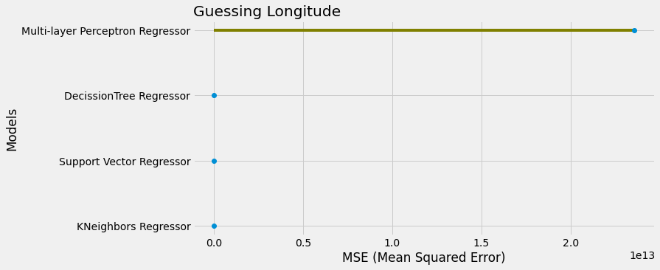
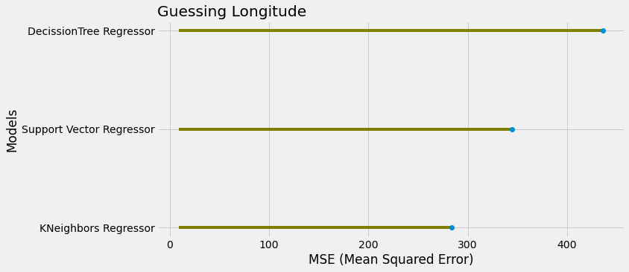
Guessing Latitude`
To guess Latitude (a continuous variable), four regression models have been trained: “K-Neighbours Regressor”, “Support Vector Regressor”, “Decision Tree Regressor” and “Multilayer Perceptron Regressor”.
Two error metrics were selected, R^2 and MSE. The R^2 metric provides an idea of the goodness of fit of a set of predictions to the actual values. 1 means perfectly fit, and 0 no-fit at all. In this case all the models are fitting very well. In the other hand, MSE measures the average of the squares of the errors (the average squared difference between the estimated values and the actual value). It’s always a positive value.
I wasn’t able to tune the parameters and hyper parameters and get decent result with MLP. With the unseen data it performed even worst.

Slide 11
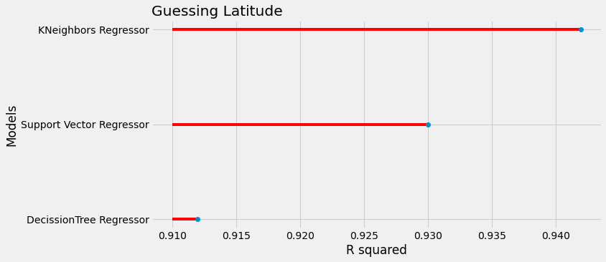
Guessing Latitude
Without MLP things are clearer: the three remaining models are performing quite well with the unseen data.
The ideal situation is a model with an r^2 closer to 1, and a MSE closer to 0. In this case KNeighborsRegressor wins in both metrics.

Slide 12
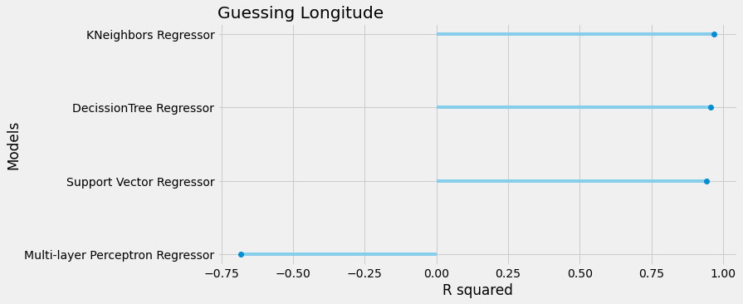
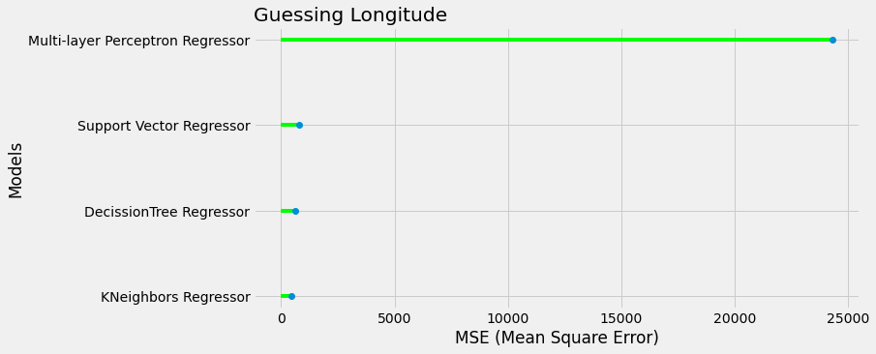
Guessing Longitude
To guess the Longitude, the same 4 modes have been trained, and the same metrics have been used.
Again MLP is performing unacceptable, and will be removed to simplify the analysis.

Slide 13
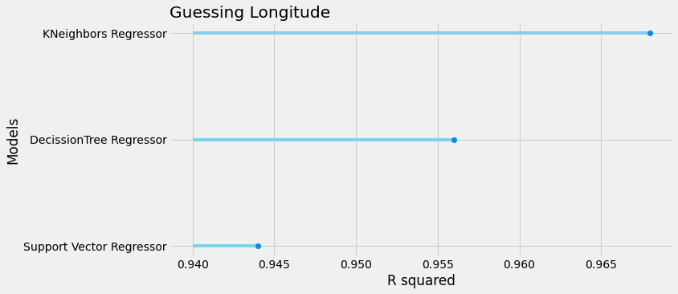
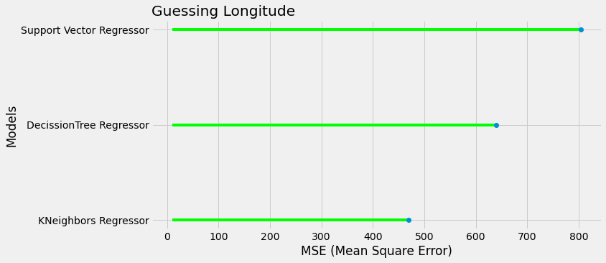
Guessing Longitude
Recalling that the ideal situation of a r^2 closer to 1, and a MSE closer to 0.
Once again KNeighborsRegressor,wins in both with an R^2= 0.968 and MSE=468.91

Slide 14
Summarizing
01
BUILDING ID
Model: Random Forest Classifier
CV = 10 folds
Tuned Decision Parameters (by Grid Search CV): {'max_depth': 60, 'max_features': 'auto', 'min_samples_leaf': 2, 'min_samples_split': 2, 'n_estimators': 20}
02
FLOOR ID
Model: Random Forest Classifier
CV = 10 folds
Tuned Decision Parameters (by Grid Search CV): {'max_depth': 60, 'max_features': 'auto', 'min_samples_leaf': 2, 'min_samples_split': 2, 'n_estimators': 40}
03
LATITUDE
Model: KNeighborsRegressor
CV = 10 folds
Tuned Decision Parameters (by Grid Search CV): {'leaf_size': 1, 'n_jobs': -1, 'n_neighbors': 2, 'weights': 'distance'}
04
Model: KNeighborsRegressor
CV = 10 folds
Tuned Decision Parameters (by Grid Search CV): {'leaf_size': 1, 'n_jobs': -1, 'n_neighbors': 2, 'weights': 'distance'}
LONGITUDE

Slide 15
Possible Improvements
Choose another combination of models/parameter/hyper parameters to guess Floor-ID.
Perhaps combine the FloorID with another feature, like SpaceID, to increase the accuracy of this feature.
Plot some latitude-longitude examples to see how they fall over the map. I imagine they could:
Understand better how the model is working, and possibly reduce it’s error.
Plotting the misclassified ones, could provide some useful information about the areas of a weak strength.

